Slide 1

FIRST PORTFOLIO PROJECT
Presented by : ARSALAN AFTAB
DATA ANALYTICS COHORT - 3

Slide 2
CONTENTS TO BE COVERED IN THE PRESENTATION
To identify the revenue generated by different employees.
To identify the number of territories in a region.
To monitor the stocks of products in inventory & engage new orders from the suppliers (Supply Chain Efficiency).
Increasing the number of products in a category by identifying the revenue of that particular category.
To figure out the top 10 high demanding & expensive products.
Segmentation of contributions by different shipping companies.
Suppliers contributions in building up the inventory.
FINAL DASHBOARD

Slide 3

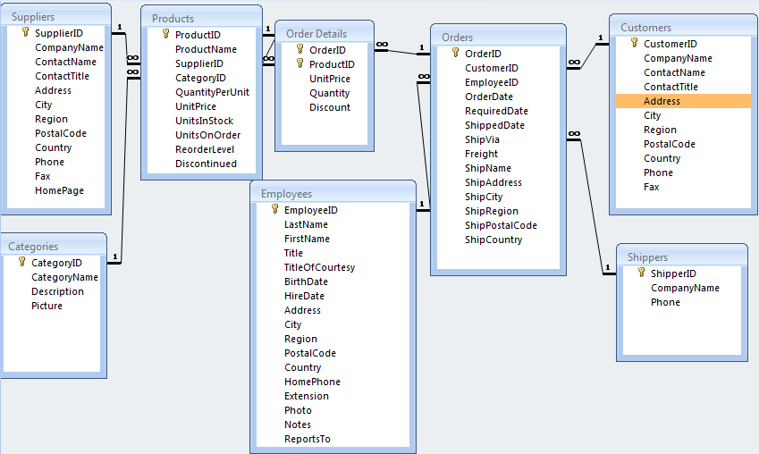
SCHEMEA

Slide 4
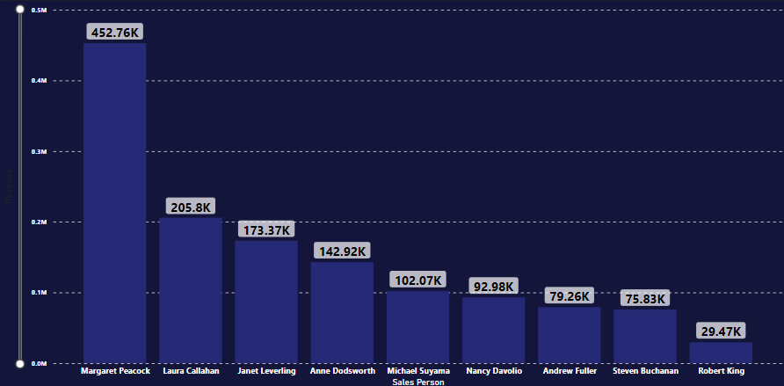
REVENUES GENERATED BY DIFFERENT EMPLOYEES

Slide 5
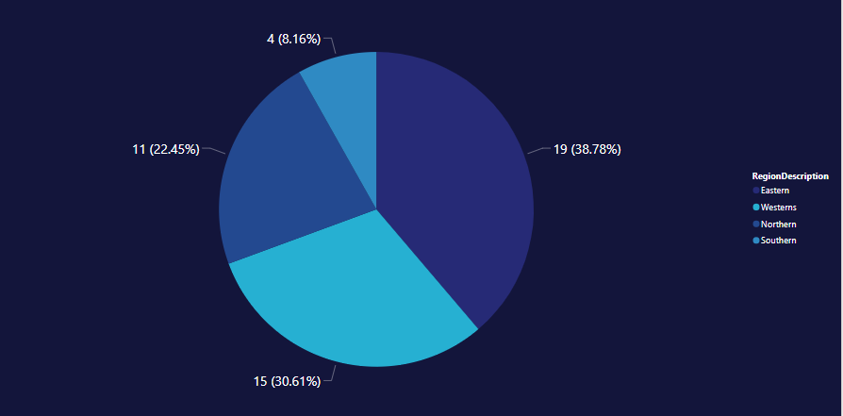
NUMBER OF TERRITORIES OF DIFFERENT REGIONS

Slide 6
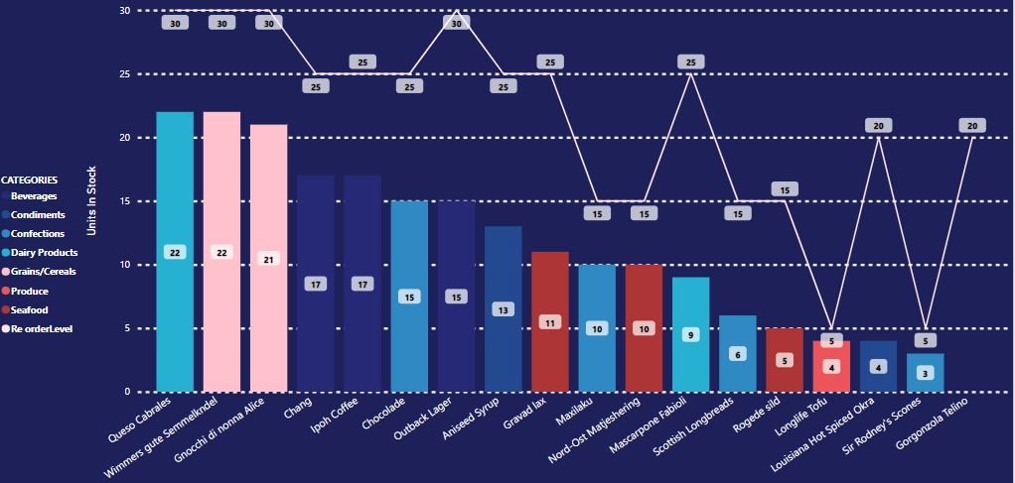
PRODUCTS THAT ARE LESS IN INVENTORY THAN RE-ORDER LEVEL LEVEL

Slide 7
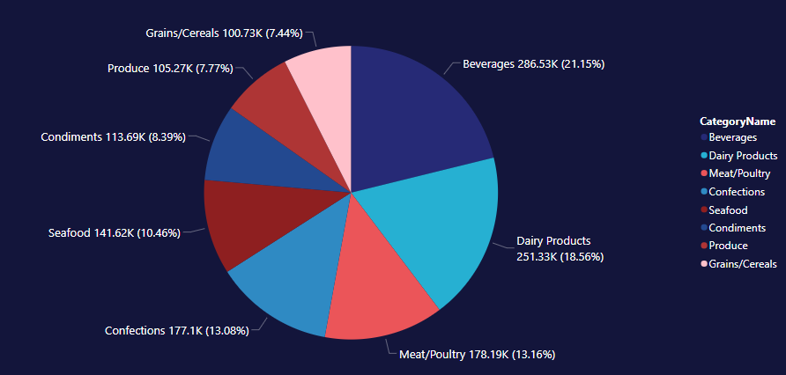
REVENUE GENERATED THROUGH DIFFERENT CATEGORIES

Slide 8
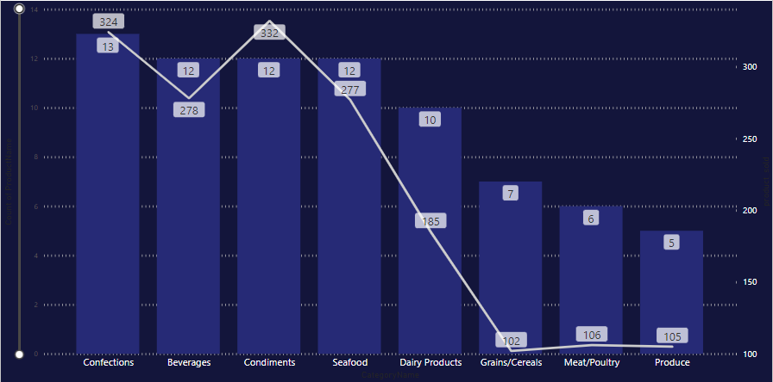
NUMBER OF ORDERS AND PRODUCTS FOR DIFFERENT CATEGORIES

Slide 9
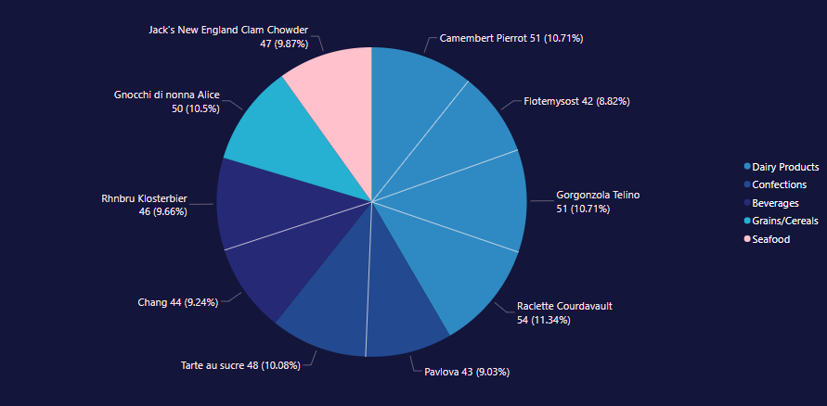
TOP TEN HIGH DEMANDING PRODUCTS

Slide 10
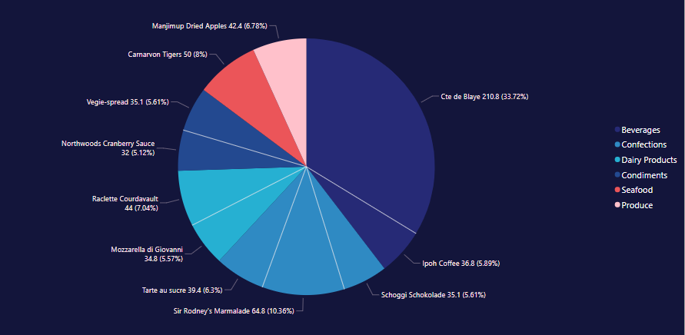
TOP TEN MOST EXPENSIVE PRODUCTS.

Slide 11
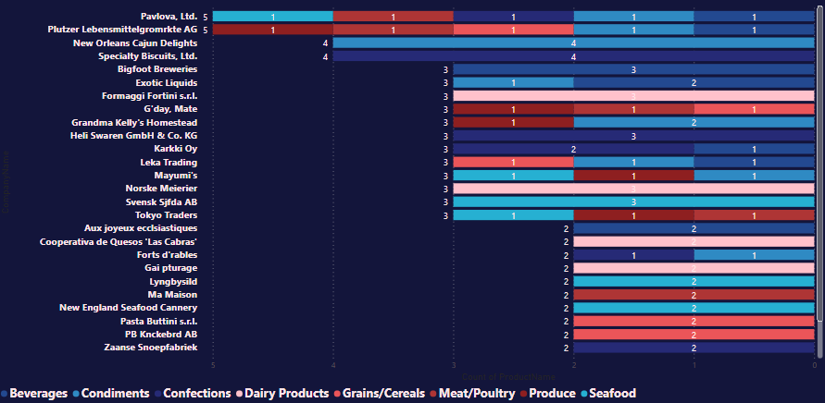
SUPPLIERS CONTRIBUTION THROUGHOUT DIFFERENT CATEGORIES

Slide 12
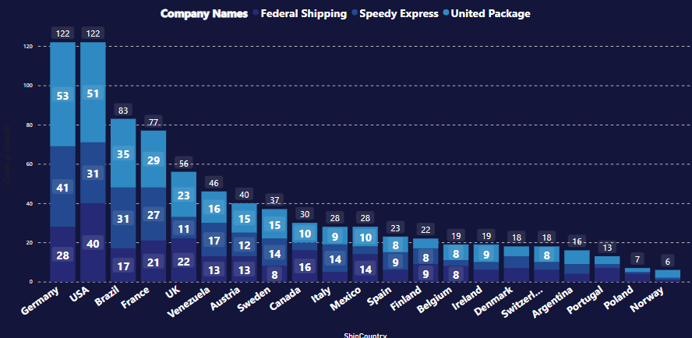
DIFFERENT DESTINATIONS DELIVERIES BY THREE SHIPPING COMPANIES

Slide 13
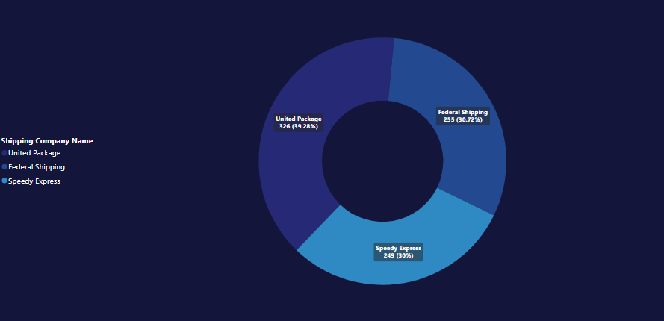
NUMBER OF ORDERS DELIVERED BY DIFFERENT SHIPPING COMPANIES

Slide 14
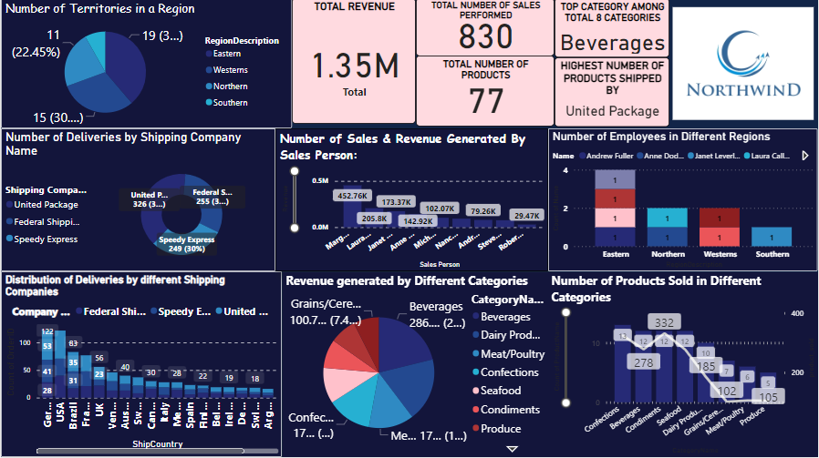

Slide 15
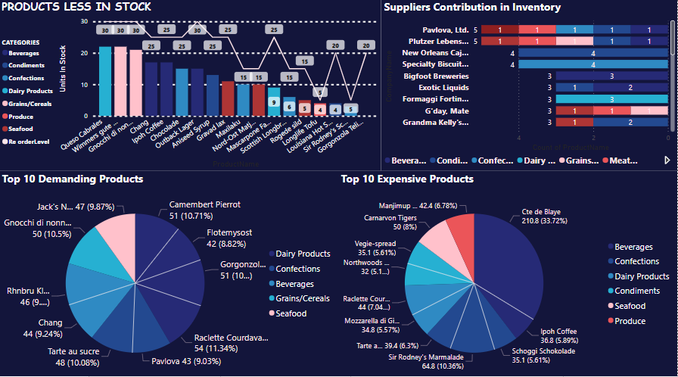

Slide 16


